Slide 1
Halide for High Performance Computing
Daniel John Kirby
Pittsburgh Supercomputing Center

Slide 2
Halide
High performance image processing language.
Functional.
Decouples algorithm from schedule.
Allows one to experiment with different schedules.

Slide 3
Big Idea
Algorithm and schedule are different things.

Slide 4
Algorithm: What needs to be done to our data.
Schedule: What order we do it in.

Slide 5
Big Idea
Most image processing involves a “pipeline.”
Pipelines involve producer and consumer function pairs.
Producer/consumer locality is important.

Slide 6
Three Moving Parts
Redundant computation
Memory bandwidth
Parallelism
Here, you need to know something about the hardware.

Slide 7

Case Study: Box Blur
Each pixel becomes the average of itself and its four nearest neighbors

Slide 8
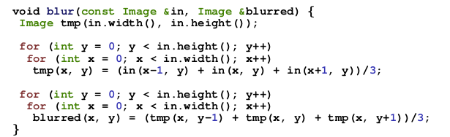
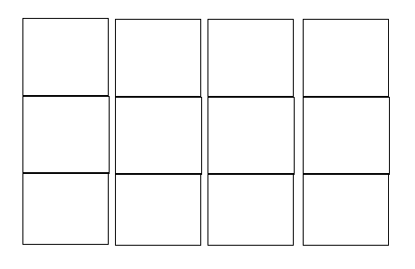
Example: Naive C/C++ Blur Algorithm
Stage 1
Stage 2

Slide 9
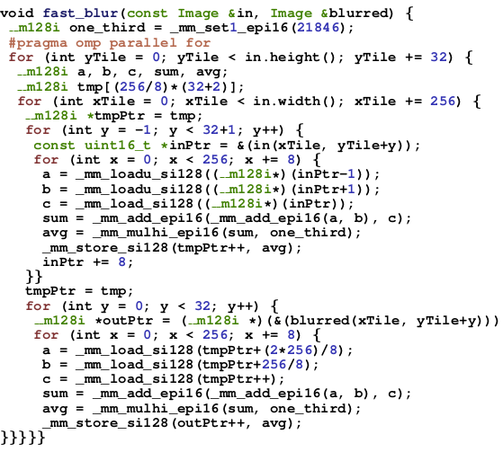
Optimized C++ Implementation

Slide 10
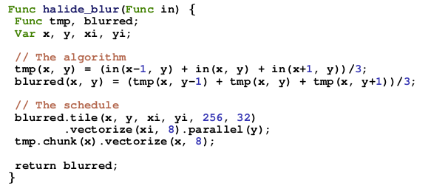
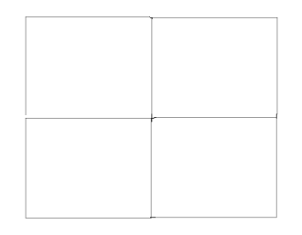
Halide implementation
Compute caller function in parallel , vectors of 8 in the x dimension

Slide 11
Negative Points
New programming paradigm.
Clumsy installation.
Daily updates often cause breakage. (Is currently broken.)
JIT Compilation.
Only does functional, feed-forward pipelining.

Slide 12
Positive Points
Write algorithm once, schedule many times. Easy optimization.
Functional style and pipeline paradigm is natural for images.
Responsive support base on github.
Code remains human-readable.
No need for a heroic compiler.

Slide 13
Nuts and Bolts
JIT Compilation vs. Static
Can compile to multiple targets, easy GPU compilation.
Installation procedure
  Requires llvm and clang.
  I had to compile both from source to get it to work.
    Takes 30-90 minutes. (Depends how many problems you run into.)
    Can be a bit of a mess.
Halide is still a moving target
  Fixes get pushed every day on github.
    Always run latest and greatest or pick one that works and run with it?

Slide 14
Summary
Halide is a powerful resource.
  Allows us to find high performance code by guess-and-check.
  A promising option in a three moving part world.
Documentation is a bit lacking.
Halide is a work in progress.

Slide 15
Resources
Halide:
  Halide-lang.org
  Github.com/halide/Halide
Me:
  dkirby@cmu.edu
  dkirby.org
  github.com/djohnkirby/PSC

